Slide 1
Memory management

Slide 2
Memory Management
Subdividing memory to accommodate multiple processes
Memory needs to allocated efficiently to pack as many processes into memory as possible
Provides multitasking facility
Responsible for memory allocation, de-allocation and keep track for each location

Slide 3
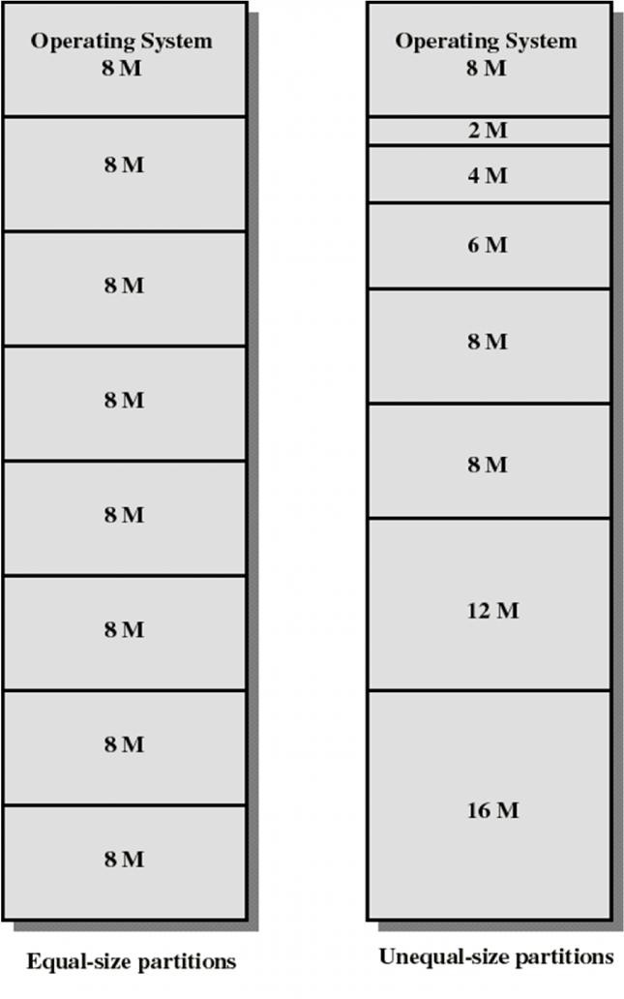
Fixed Partitioning
Partition of main memory into a set of non-overlapping memory regions called partitions
Fixed partitions can be of equal or unequal sizes
Leftover space in partition after program assignment is called internal fragmentation

Slide 4
Problems in Fixed Partitioning
Main memory use is inefficient.
A program occupies an entire partition which can cause internal fragmentation.
Unequal-size partitions reduces the problem little bit.

Slide 5
Dynamic Partitioning
Partitions are of variable length and number
Process is allocated exactly as much memory as required
Eventually get holes in the memory. This is called external fragmentation
Must use compaction to shift processes so they are contiguous and all free memory is in one block

Slide 6
Example Dynamic Partitioning
Operating
System
128 K
Operating
System
Operating
System
Process 1
320 K
Process 1
320 K
Process 2
224 K
896 K
576 K
352 K

Slide 7
Example Dynamic Partitioning
Operating
System
Operating
System
Operating
System
Process 1
320 K
Process 1
320 K
Process 1
320 K
224 K
224 K
Process 4
128 K
Process 2
96 K
Process 3
288 K
Process 3
288 K
Process 3
288 K
64 K
64 K
64 K

Slide 8
Example Dynamic Partitioning
Operating
System
Operating
System
320 K
Process 2
224 k
96 K
Process 4
128 K
Process 4
128 K
96 K
96 K
Process 3
288 K
Process 3
288 K
64 K
64 K

Slide 9
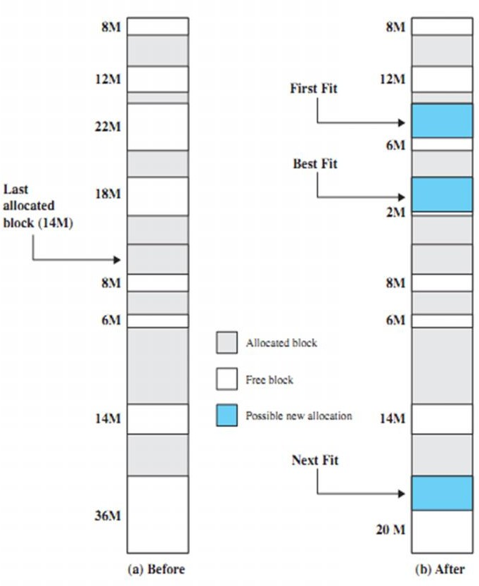
Placement Algorithms
Used to decide which free block to allocate to a process of 16MB.
Goal: reduce usage of compaction procedure (its time consuming).
Example algorithms:
First-fit
Next-fit
Best-fit
Worst-fit
Continued

Slide 10
First fit
Starts scanning memory from the beginning and chooses the first available block that is large enough.
Implementation:
1- Input memory blocks with size and processes with size.
2- Initialize all memory blocks as free.
3- Start by picking each process and check if it can be assigned to current block.
4- If size-of-process <= size-of-block if yes then assign and check for next process.
5- If not then keep checking the further blocks.

Slide 11
Next-fit
Starts scanning memory from the location of the last placement and chooses the next available block that is large enough
Implementation:
Input the number of memory blocks and their sizes and initializes all the blocks as free.
Input the number of processes and their sizes.
Start by picking each process and check if it can be assigned to the current block, if yes, allocate it the required memory and check for next process but from the block where we left not from starting.
If the current block size is smaller then keep checking the further blocks.

Slide 12
Best-fit
Chooses the block that is closest in size to the request
Implementation:
1- Input memory blocks and processes with sizes.
2- Initialize all memory blocks as free.
3- Start by picking each process and find the minimum block size that can be assigned to current proc
ess i.e., find min(bockSize[1], blockSize[2],.....blockSize[n]) > processSize[current], if found then assign it to the current process.
4- If not then leave that process and keep checking the further processes.

Slide 13
Worst-fit
It searches whole list & fine the largest memory- hole to allocate a process.
Implementation:
1- Input memory blocks and processes with sizes.
2- Initialize all memory blocks as free.
3- Start by picking each process and find the maximum block size that can be assigned to current process i.e., find max(bockSize[1], blockSize[2],.....blockSize[n]) > processSize[current], if found then assign it to the current process.
5- If not then leave that process and keep checking the further processes.

Slide 14
Problem
Computer Systems Engineering Department, QUEST, Nawabshah 14CS
Question # 1
Consider a swapping system in which memory consists of the following hole sizes in memory order: 10K, 4K, 20K, 18K, 7K, 9K, 12K and 15K. Which hole is taken for successive segment requests of (a) 12K, (b) 10K, (c) 9K for first fit? Repeat the question for best fit, worst fit and next fit.
(a) 1st fit
4K
7K
9K
10K
12K
15K
18K
20K
Block 1
12K, 10K and 9K will be allocated in Block # 5, 4, 3 respectively
Block 2
(b) Best fit
Block 3
12K, 10K and 9K will be allocated in Block # 5, 4, 3 respectively
Worst fit
12K, 10K and 9K will be allocated in Block # 8, 7, 6 respectively
Next fit
12K, 10K and 9K will be allocated in Block # 5, 6, 7 respectively
Block 4
Block 5
Block 6
Block 7
Block 8

